Slide 1

Comparative Analysis of Competitiveness in European Football League and MLS
Xingyang (Simon)Chen

Slide 2
Research Question
What Key Team-level Performance Metrics Do European Football Leagues Demonstrate Greater Competitiveness Than MLS?
Foundational Assumption:
European Leagues are inherently more competitive than MLS
EU Leagues: Competitive = 1, MLS: Competitive = 0

Slide 3

Methodology
• Data (Fbref):
Team-level standings, fixtures, and performance stats from 2010–2024 across 5 major European leagues + MLS.
• Feature Selection:
Used RFECV to choose top predictive metrics
• Modeling Approaches:
Logistic Regression & Decision Tree Classifier
• Cross-Validation:
Stratified K-Fold CV (5-fold)
• Two Datasets Modeled:
All teams across all seasons
Only qualified/high-performing teams (e.g., UEFA or conference teams)

Slide 4
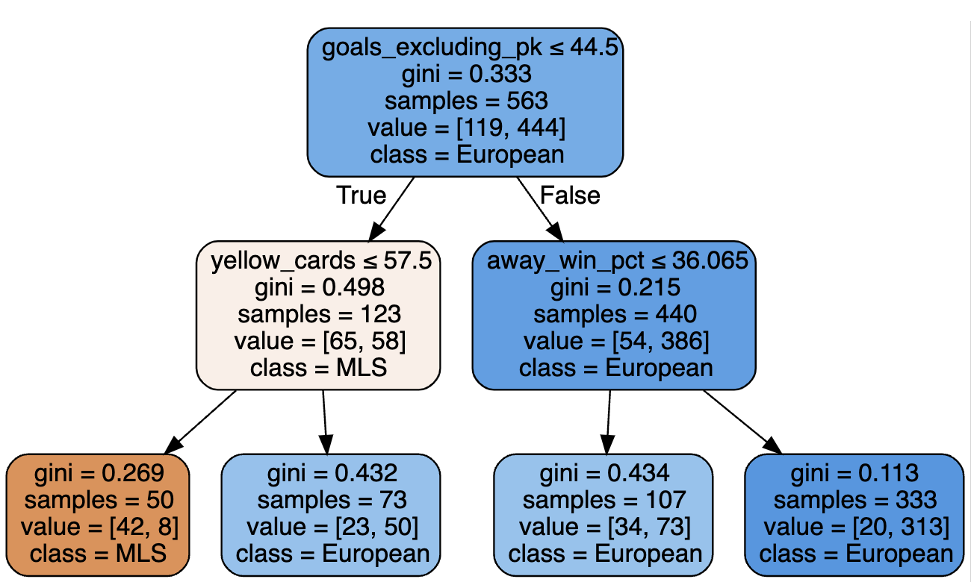
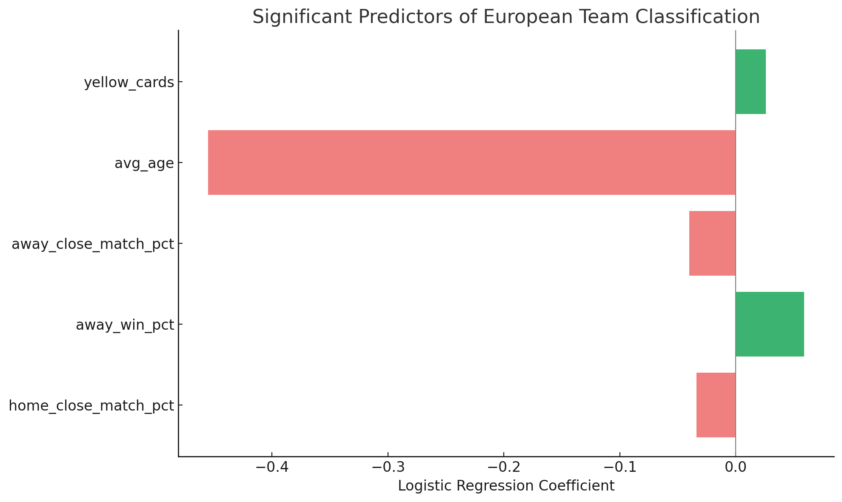
Results
0.026
-0.455
-0.04
P = 0.000
0.059
-0.034
Notes:
✅ 1. home_close_match_pct (coef = -0.034, p = 0.000)
Interpretation:
For every 1 percentage point increase in close matches at home (games decided by just one goal), the odds of the team being from a European league decrease.
Implication:
European teams tend to win or lose by wider margins at home, suggesting greater dominance or disparity, whereas MLS teams are more likely to be involved in tight, close home matches.
✅ 2. away_win_pct (coef = 0.059, p = 0.000)
Interpretation:
A 1 percentage point increase in away win percentage increases the odds of being a European team.
Implication:
European teams are generally stronger on the road, showing tactical quality and resilience away from home. This is a key marker of competitive quality, while MLS teams often struggle more in away games.
✅ 3. away_close_match_pct (coef = -0.040, p = 0.000)
Interpretation
For every 1 percentage point increase in away matches decided by one goal, the odds of being a European team decrease.
Implication:
Similar to home games, European teams are less involved in close away games, indicating they either dominate or fall short decisively. MLS teams play more evenly matched away games, which could suggest more parity—or lower overall control.
✅ 4. avg_age (coef = -0.455, p = 0.000)
Interpretation:
A one-year increase in average squad age decreases the odds of being a MLS team (or, positively associated with being European).
Implication:
MLS teams have younger squads on average, likely due to differences in player development pipelines, international recruitment, and league maturity. European leagues, by contrast, field more veteran players, possibly reflecting a higher level of tactical and physical experience.
✅ 5. yellow_cards (coef = 0.026, p = 0.001)
Interpretation:
Each additional yellow card is associated with higher odds of being a European team.
Implication:
European teams commit more fouls that result in bookings, which could indicate a more aggressive or intense style of play. This may reflect stronger defensive pressure, tactical fouls, or higher match stakes overall.

Slide 5

Takeaways & Discussions
European teams are more likely to:
• Have higher away win percentages
• Drag into less close match situations (both home & away)
• Older squads
• Accumulate slightly more yellow cards.
Discussion
• Based on Common Beliefs
• Maybe reveal structural and stylistic differences, but no results:
• MLS teams show more parity and variability
• European teams show consistency, control, and tactical maturity
Future Directions
• Try unsupervised clustering to explore natural groupings without assumptions.
• Introduce more advanced metrics (e.g., expected goals, possession zones).
• Analyze off-court metrics

